Slide 1
Introducing Job Preparation Mentor: Your AI Interview Coach
Revolutionizing job search with AI-powered guidance tailored just for you.
Offers resume building, interview practice, and smart job search strategies.
Personalized feedback to help you land your dream job faster and smarter.

Slide 2
Key Features: Resume Enhancement
AI-driven Analysis
Tailored Suggestions
Identify resume strengths and weaknesses instantly.
Optimize keywords, format, and content for each job.
Real-world Impact
Profile Integration
Users improved resume scores by 40% after AI edits.
Import profiles from LinkedIn and Indeed effortlessly.

Slide 3




Ace the Interview: Practice Makes Perfect
Realistic Simulations
Practice behavioral, technical, and situational questions.
Comprehensive Bank
Thousands of commonly asked interview questions available.
Instant Feedback
Evaluate answers on clarity, conciseness, and STAR method.
User Confidence
90% felt more confident after practice sessions.

Slide 4
Personalized Learning Paths: Customized for You
Skills Assessment
Industry Focus
Progress Tracking
Identify gaps to recommend targeted learning plans.
Training tailored for specific roles like software engineering.
Earn badges and stay motivated with milestone tracking.

Slide 5
Real-time Feedback and Analytics: Data-Driven Improvement
Performance Metrics
Sentiment Analysis
Track your improvement over time clearly and quantitatively.
Understand emotional tone and delivery during interviews.
Targeted Growth
Proven Results
Identify weaknesses to refine your technique effectively.
Users improved response clarity by 25% after feedback.

Slide 6
Seamless Integration: Your Job Search Ecosystem
Job Board Connections
Calendar Sync
Mobile Access
Apply directly using one-click to Indeed, Monster, LinkedIn.
Schedule interviews and reminders with calendar integration.
Prepare anytime, anywhere via the mobile app.

Slide 7
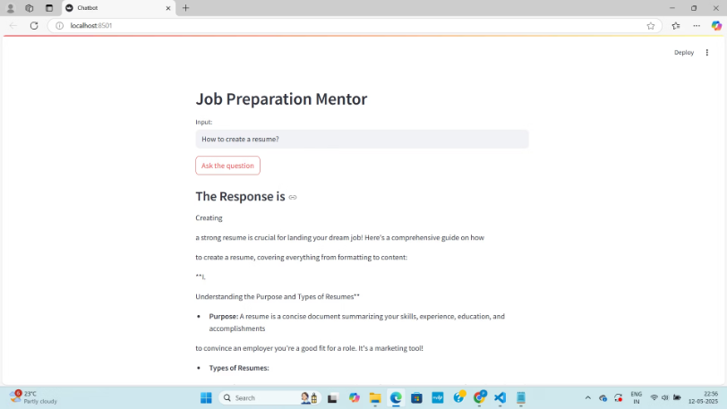
DEMO SCREENSHOT
This is a Demo Screenshot of our Chatbot.

